Slide 1
Flight Planning Exercise

Slide 2
Steps for a great flight
Set up your route
Review altitudes, airspace
Prepare navigation log
Weather Brief
NOTAMs

Slide 3
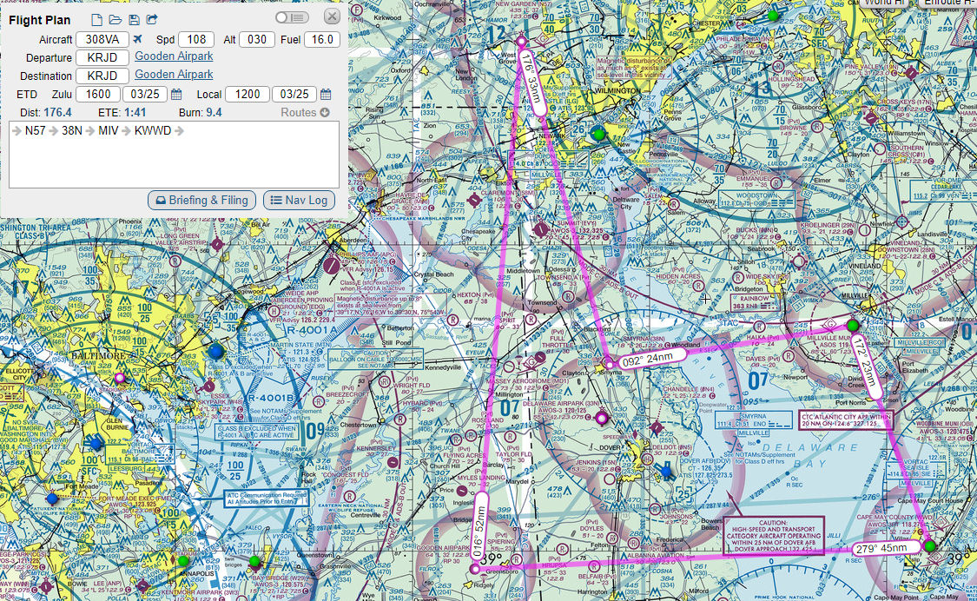

Slide 4
Steps for a great flight
Set up your route
Review altitudes, airspace
Prepare navigation log
Weather Brief
NOTAMs

Slide 5
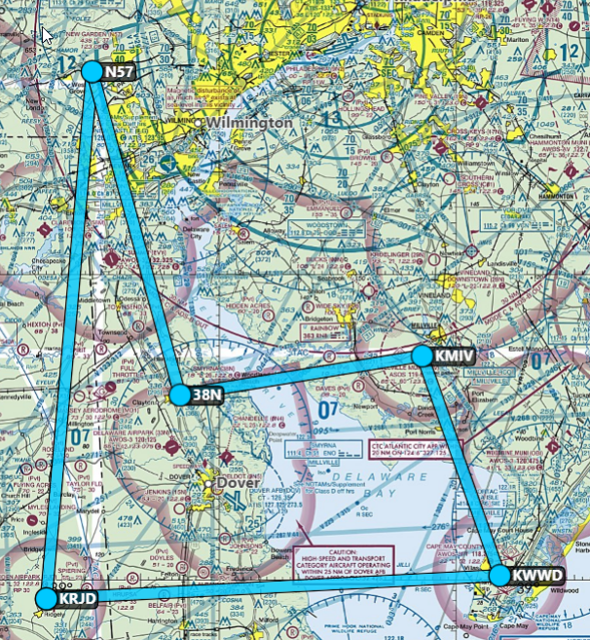

Slide 6
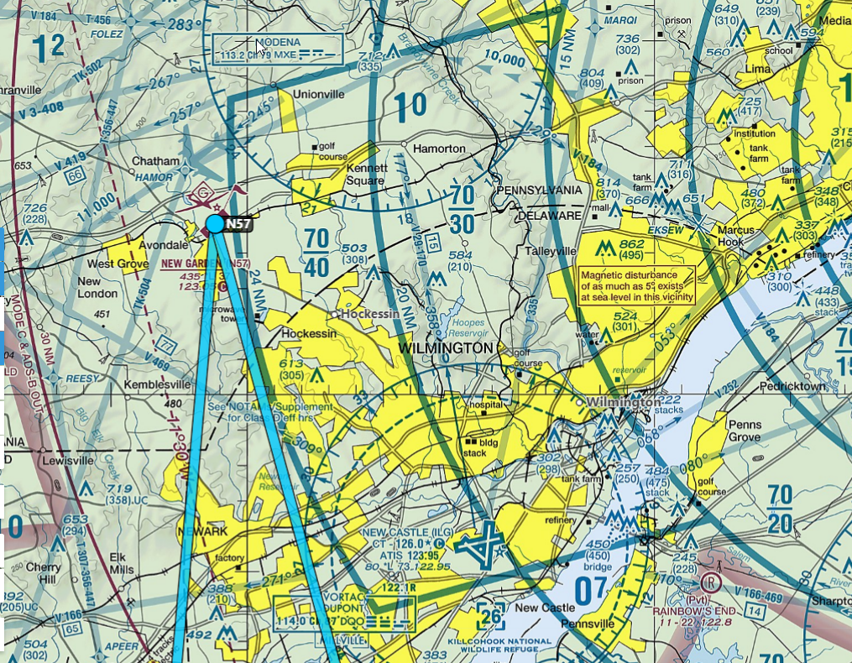

Slide 7
Steps for a great flight
Set up your route
Review altitudes, airspace
Prepare navigation log
Weather Brief
NOTAMs

Slide 8
Items to gather
True heading
Leg distances
Magnetic variation
Wind speed and direction
Communications frequencies
AWOS/ATIS frequencies
Runway length(s)
Services (especially fuel)

Slide 9
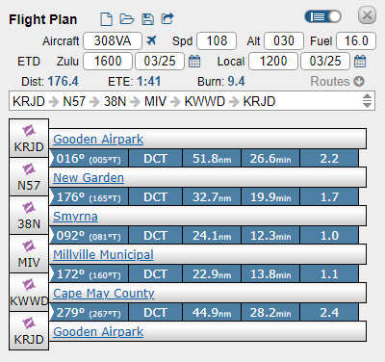

Slide 11
Items to gather
True heading
Leg distances
Magnetic variation
Wind speed and direction
Communications frequencies
AWOS/ATIS frequencies
Runway length(s)
Services (especially fuel)

Slide 12
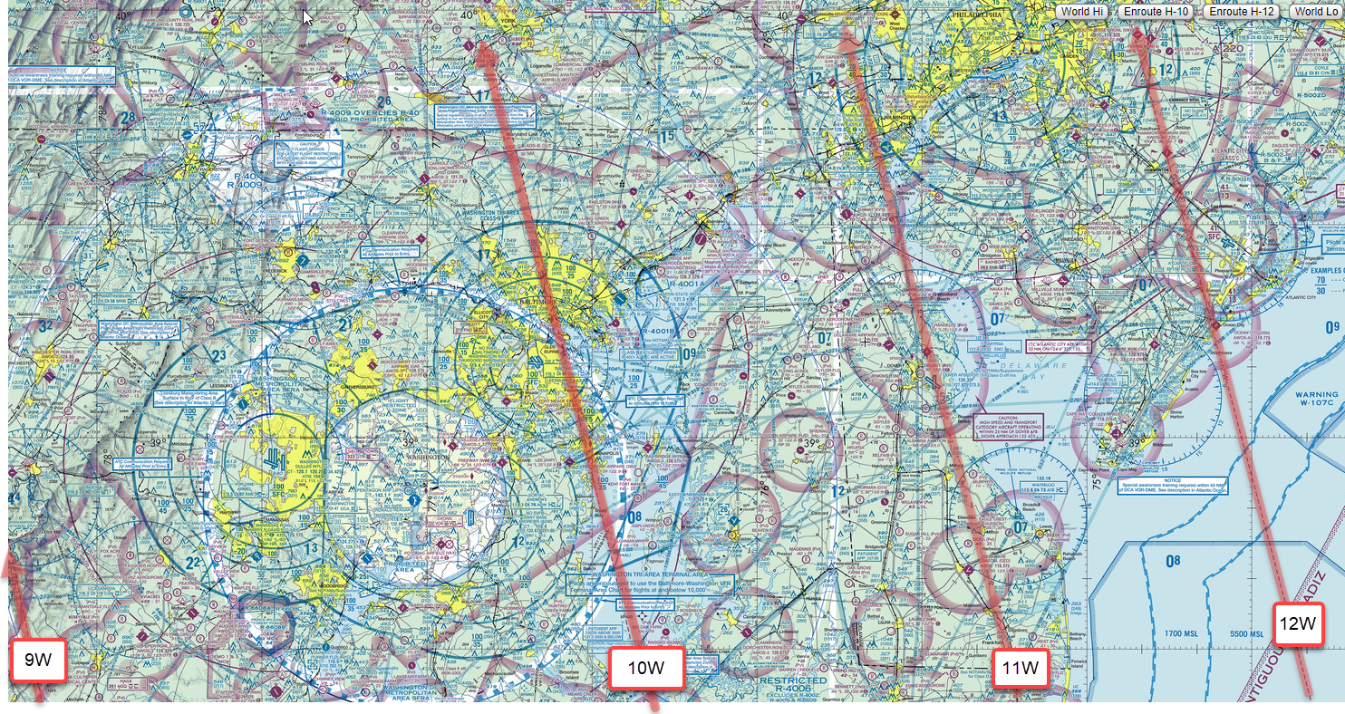

Slide 14
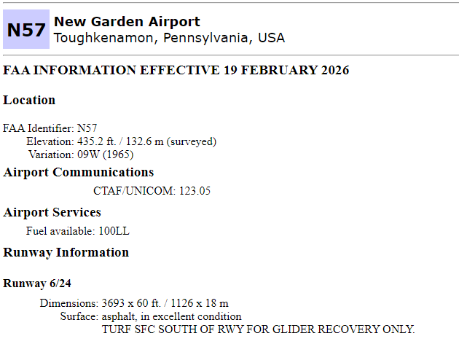
https://www.airnav.com/airport/

Slide 15
Items to gather
True heading
Leg distances
Magnetic variation
Wind speed and direction
Communications frequencies
AWOS/ATIS frequencies
Runway length(s)
Services (especially fuel)

Slide 16
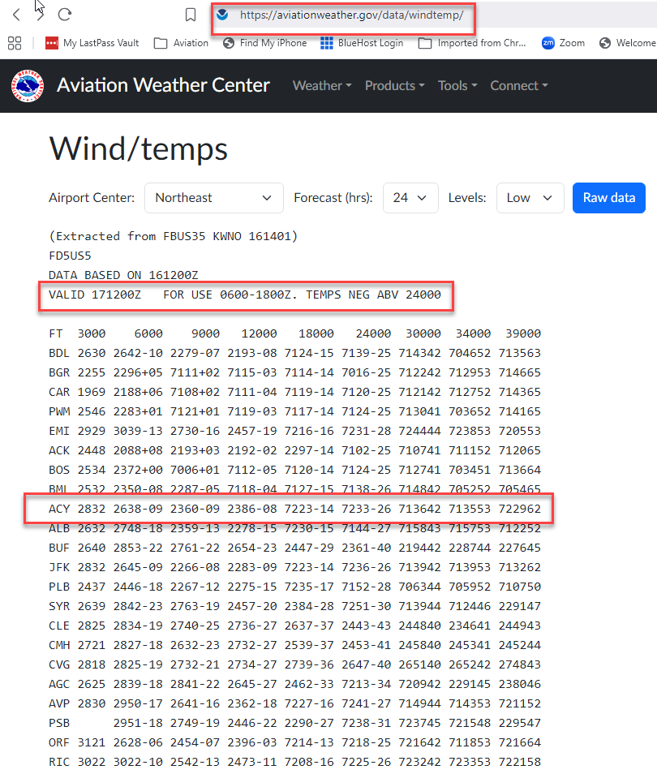

Slide 18
Three more variables and we can calculate everything else in the table
  Aircraft airspeed
  Fuel on board
  Fuel burn (gallons/hour)

Slide 20

And through the magic of Excel

Slide 22
Items to gather
True heading
Leg distances
Magnetic variation
Wind speed and direction
Communications frequencies
AWOS/ATIS frequencies
Runway length(s)
Services (especially fuel)

Slide 23
Steps for a great flight
Set up your route
Review altitudes, airspace
Prepare navigation log
Weather Brief
NOTAMs

Slide 24
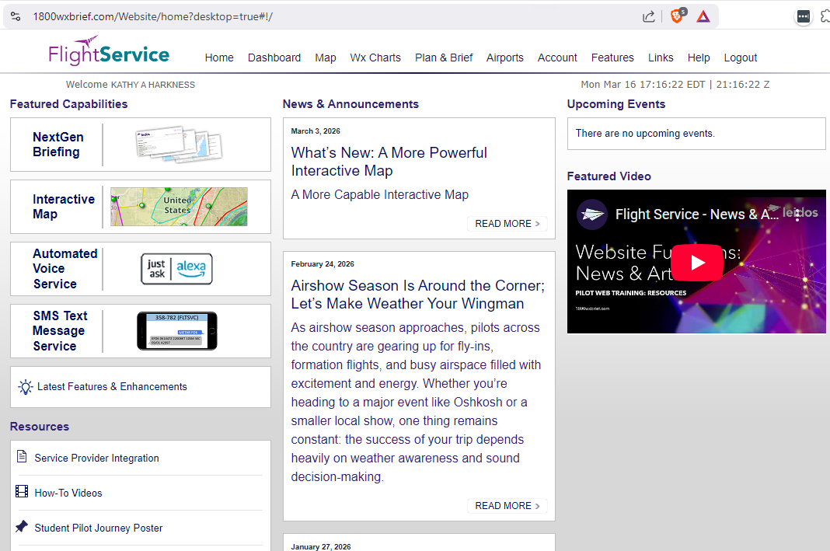
1800WXBRIEF.COM

Slide 26
Steps for a great flight
Check weight and balance
Review takeoff and landing distances
File a flight plan if desired

Slide 27
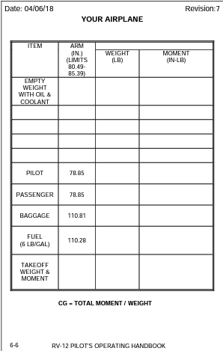
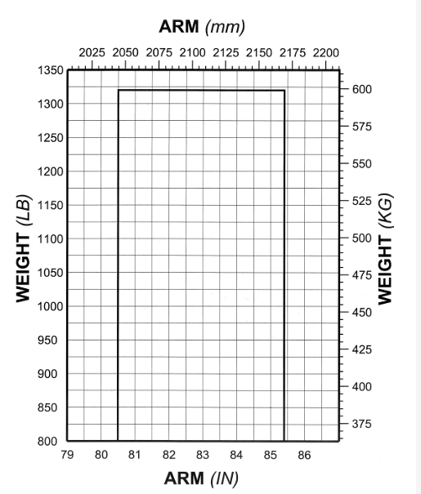

Slide 29
Steps for a great flight
Check weight and balance
Review takeoff and landing distances
File a flight plan if desired

Slide 30
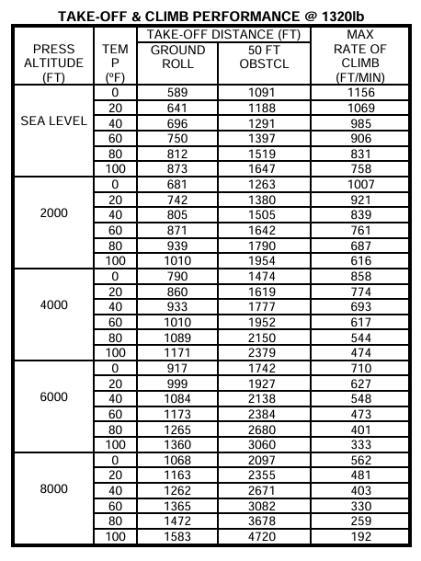

Slide 31
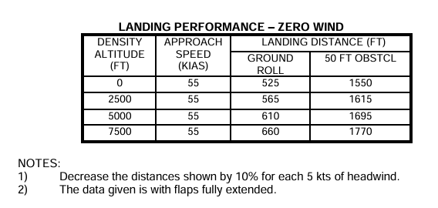

Slide 32
Steps for a great flight
Check weight and balance
Review takeoff and landing distances
Review preferred runways
File a flight plan if desired

Slide 33
Current conditions
Temperature: 17 C°
Pressure: 29.45 “ Hg
Wind direction 280° true
Wind velocity: 18 gusting 32

Slide 35
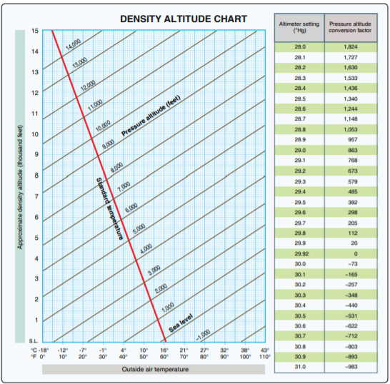
Pressure and density altitudes
PA conversion factor for 29.45:
(485-392)/2 = 11.5
392 + 11.5 = 404
Add 404 to field elevation at 38N:
404 + 18 = 422
Read DA from chart: ~ 800 ft.

Slide 36
Even at the most pessimistic limit (PA 2000 ft, 50 ft obstacle)
The 2,600 ft runway at Smyrna is long enough.

Slide 38
Least favorable runway: 24 at New Garden (N57)
280 true = 292 magnetic.
29 – 24 = 50 degree angle

Slide 39
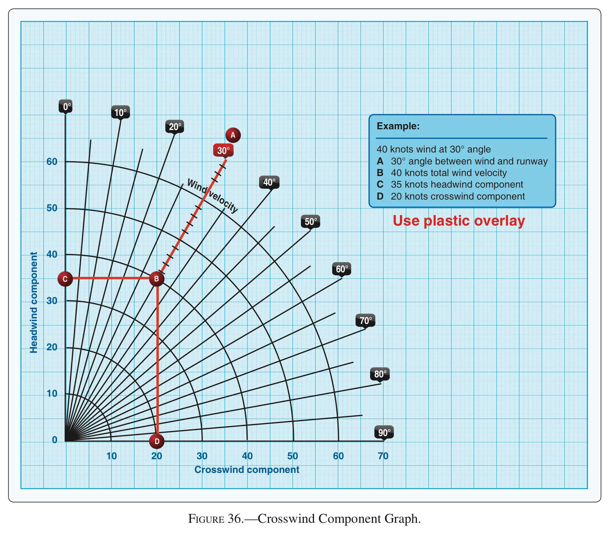

Slide 40
Steps for a great flight
Check weight and balance
Review takeoff and landing distances
Review preferred runways
File a flight plan if desired

Slide 41
After you launch
Execute ded reckoning per navlog
Evaluate with pilotage and crosschecks at checkpoints
Alter nav log as needed to account for unexpected conditions
Listen to weather from nearby AWOS/ATIS
Monitor 121.5 (Guard)

Slide 42
After you land
Note total time en route
If refueling, note fuel added
Alter nav log as needed to account for unexpected conditions

Slide 43
Thursday March 19:
Engines and electrical systems
Machado Chapters 3 & 4
Pilot’s Handbook Chapter 7

